Slide 1
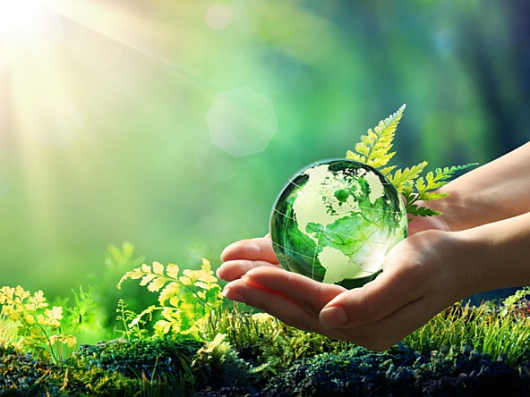
Higher Design & Manufacture
Environment

Slide 2


Learning intentions & success criteria
Learning Intentions
Understand the impact of designing and manufacturing technologies on the environment.
Success Criteria
Describe and explain the impact on the environment:
  Energy production
  Consumption
  Pollution

Slide 3
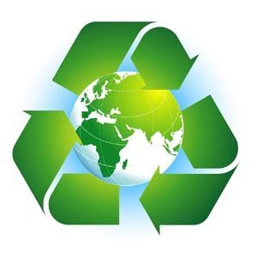
Environmental considerations in design
Alongside design factors, we must also consider the environmental impact of design and manufacture on the environment and society.
Designers are environmentally responsible for the products produces. They must ensure that products work in harmony with the environment or positively add to it in their use and disposal.

Slide 4
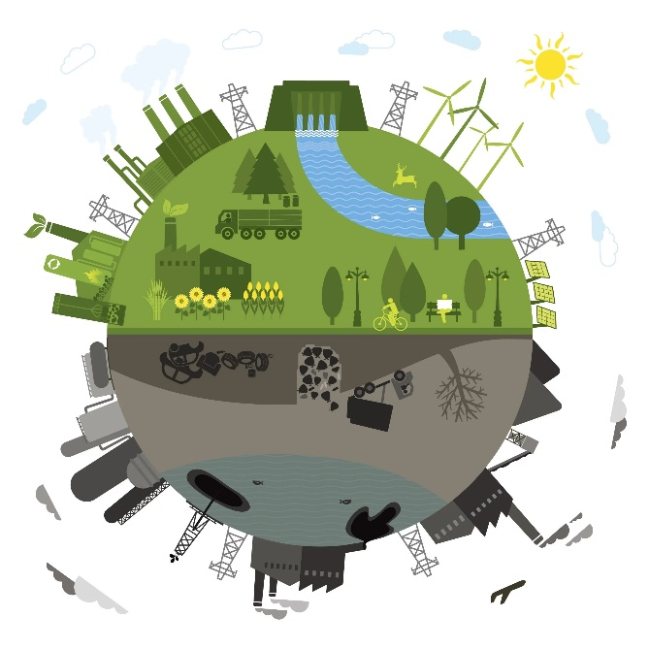
Impact of manufacturing on the environment
Manufacturing has negative effects on our environment:
Use the Earth’s resources for energy and material.
Generate waste
Create pollution
This is done through:
Manufacturing
Transportation
Disregarded Products
Packaging
This has impacted the environment and societies across the world and we are dealing with climate change at the same time, create natural disasters and decreasing biodiversity as habitats disappear.

Slide 5
Product Life Cycle
Landfill
Recycling
Source
Raw Materials
Source
Components
There are many stages in the life cycle of a product which can impact on the environment, from the pollution caused by the transportation of the materials to the factory, to the packaging of the product that is disposed of in landfill.
The diagram below shows each of the stages of a product’s life cycle. This is all about sustainability, which is explained on the following page.
Disassembly
Manufacturing
Re-use/ Recycle
Assembly
Repair/
Maintain
Package
Use
Deliver to Retailer
Unpackage
Consumer Purchase
Transport Home

Slide 6
Landfill
Recycling
Source
Raw Materials
Source
Components
Disassembly
Manufacturing
Re-use/ Recycle
Assembly
Repair/
Maintain
Package
Key
Possible Links
Deliver to Retailer
Raw Materials Wasted
Use
Energy (heat/power/light/fuel)
Consumer Purchase
Unpackage
Raw Materials
Transport Home
Pollution to air/water/soil
Pollution from transport

Slide 7
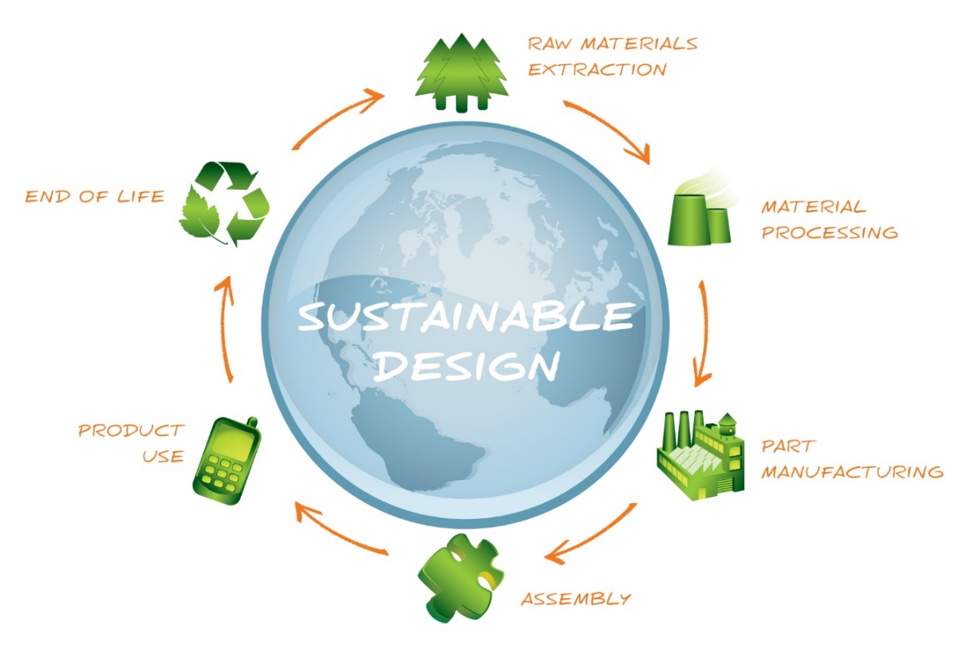
sustainability
A sustainable product is one which:
Is designed to have minimal negative impact on the environment
Does not use finite resources
Cause pollution or damage the Earth’s environment.
Its manufacture takes into account the social aspects of production in that it does not damage natural habitats to source materials.
It is not produced by people working in exploitative conditions.
Whilst it is difficult to ensure a product is manufactured sustainably, transported and disposed of safely, efforts must be made to have as little impact as possible.

Slide 8
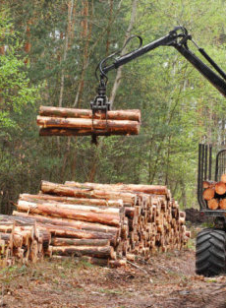
Sustainable materials
A sustainable material is something whose production is supported indefinitely by nature, i.e. a resource is used up at the same time it’s renewed.
Wood is a sustainable resource because trees are both harvested, planted and grown all the time. However, even some woods, e.g. hardwoods, are less sustainable, depending on the time it takes them to grow and mature.
By using salvaged materials, this minimises waste and further natural resources being depleted.

Slide 9
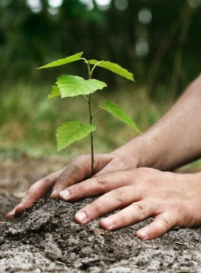
Sustainable design
At all stages in the development, manufacture, use and disposal of a product, sustainability/environmental issues have to be considered:
Can the product be made from renewable/recycled materials?
Are the materials biodegradable?
Are the proposed materials recyclable?
How will it be manufactured?
Is the product and manufacturing processes energy efficient?
Can natural power sources be used?
How will the product be packaged?
How will the product be transported to the market place?
Can the product be easily repaired?
Have waste and by-products been kept to a minimum?
Have all types of pollution been kept to a minimum?

Slide 10
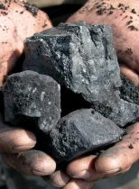
Finite resources
Sourcing materials to manufacture products can cause environmental damage. Mining materials from the Earth, such as ore for metal, must be done responsibly as these are finite or non-renewable resources.
Over-mining can ruin landscapes, affect wildlife by causing los of habitats and, in extreme cases, bring about landslides. Finite resources form over very long periods of time and cannot be replaced in a human lifetime. Therefore, they must be used responsibly and be recycled if possible.

Slide 11
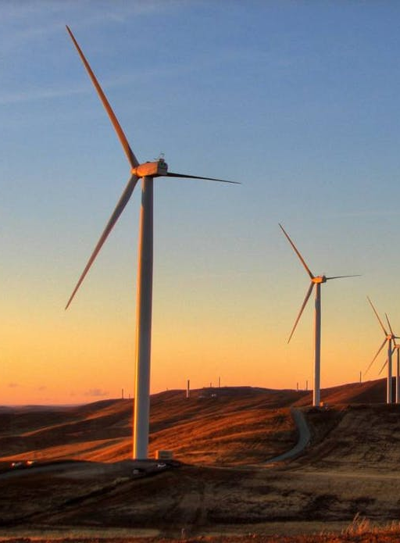
Renewable resources
Renewable resources are the materials which we have the capability to produce, such as wood or biopolymers. For example, wood is said to be a renewable resource as a new tree can be planted to replace one that is cut down.
This is a sustainable approach to managing materials, ensuring wood will be available for years to come. However, if the trees are not replaced, use of wood becomes unsustainable and such harvesting causes irreparable environmental damage.

Slide 12
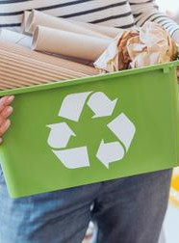
Recycling materials
Assuming that all the materials used in the product are recyclable and that the user has taken the time to separate the materials correctly, then the product’s materials can be used again.
This is the best case scenario. The worst case scenario is when the materials used in the product are no recyclable (some manufactured boards for example). Or, when the user does not recycle and the product ends up in a landfill.

Slide 13
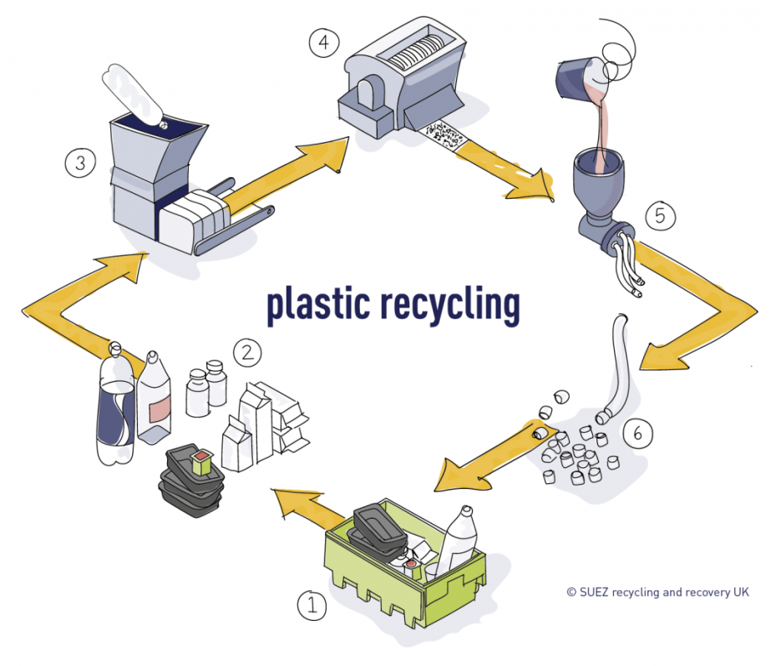
Cradle-to-grave design
When products are designed without any consideration of how the materials can be reused, it is said that these are ‘cradle-to-grave’ products.
These products use raw materials which either cannot be recycled, are very difficult to recycle or the parts of the product are difficult to separate for recycling.
They waste our natural resources and cause pollution in landfills. Such products are part of a linear economy because they reach an end point, and this type of manufacturing is sometimes referred to as ‘take, make, dump.’
Steps of Recycling Plastic
Collection
Sorting (by size and type)
Baling (compressed into cuboids)
Shredding and Cleaning
Melting and extrusion
Palletising for further use

Slide 14
The term ‘cradle-to-cradle’ is used to describe design and manufacture in total harmony with the Earth; whatever we take from the land must eventually be returned to nature.
This approach is about designing for disassembly, to allow the separation of the materials, so they can be reused, reprocessed or recycled.
The materials can be cascaded through different uses until they can be returned to nature. Therefore, when selecting an appropriate material, the entire life cycle of the product must be considered.
Some materials, such as biopolymers made from corn starch, are designed for the biological cycle. These materials are biodegradable and are safely returned to the Earth through composting as they contain no harmful toxins.
When all the materials can be reused or returned to nature, this is called a ‘closed loop’ or ‘circular economy approach.’ This means products must be:
100% recyclable
Not damage the Earth with any chemicals or toxic waste
Not disturb or damage the Earth’s ecosystem
Be manufactured using renewable energy sources
The cradle-to-cradle approach can preserve our natural resources, minimise air pollution and have an overall neutral or positive impact on the environment.
1
Product is Manufactured
2
Product is Used
5
3
Raw Materials are Used to Make New Products
Product Reaches End of Use
4
Materials are Separated and Segmented

Slide 15
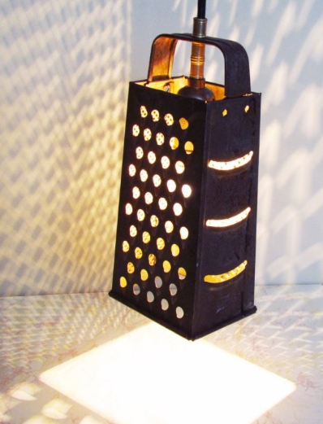
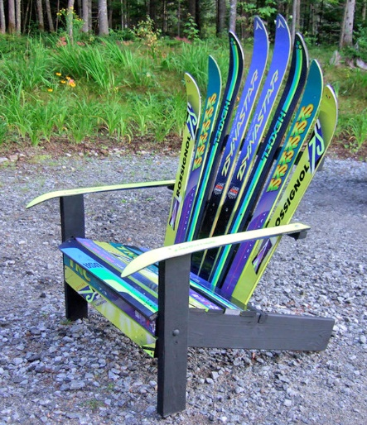
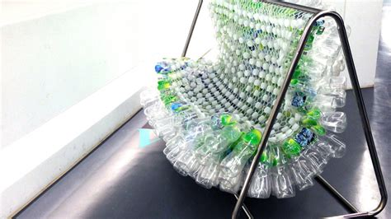
Upcycling materials
It is popular for designers to use materials from discarded products instead of using raw materials. This is called upcycling as it gives old products a new lease of life.
It is an extremely good way of working sustainably as it incorporates the six R’s of recycling:
REDUCE
RETHINK
REFUSE
RECYCLE
REUSE
REPAIR
Upcycling is a positive approach compared to recycling. With recycling, materials can degrade in quality each time they are recycled.
Recycling may also involve energy and water consumption, and often transportation.

Slide 16
Measures to support sustainability
N
on-toxic substitutes
O
ptimise raw material use
Sustainability, which is using the Earth’s resources responsibly and at a rate whereby the Earth will be able to provide for future generations, is everyone’s responsibility.
Designers and manufacturers must aim to reduce the environmental impact of the products they design and manufacture to protect our environment and limit the use of resources. This is known as clean manufacturing and it includes;
Sourcing materials sustainably and/or locally
Minimising transportation
Energy consumption
Waste from obsolescent or difficult-to-repair products
NO WASTE
The NO WASTE acronym below will help you remember the key points of a clean manufacturing system:
W
ater use and water reduction
A
ir emission reduction
S
olid and hazardous waste reduction
T
ransport package optimisation
E
nergy efficiency

Slide 17
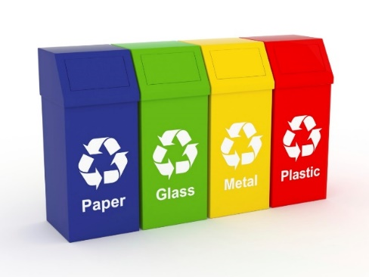
Recommendations for designers
The following points are for product designers to consider during the entire design process with regards to the environment;
Use alternative materials which are recyclable
Reduce the volume of the material (e.g. thinner walls on plastic products or hollowed out parts)
Reducing the number of parts and components
Designing the product for disassembly (see cradle-to-cradle design)
Using recycled components and parts
Consider how products are packaged e.g. flat pack to save space and transportation costs, leading to reduced pollution of the environment
Consider increasing the life-expectancy of a product (how long it is intended to be used for/can be used for before it needs replaced).

Slide 18
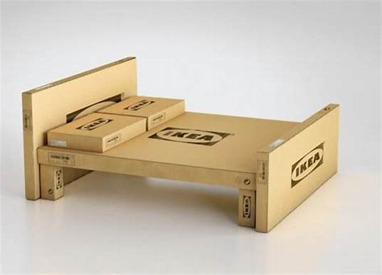
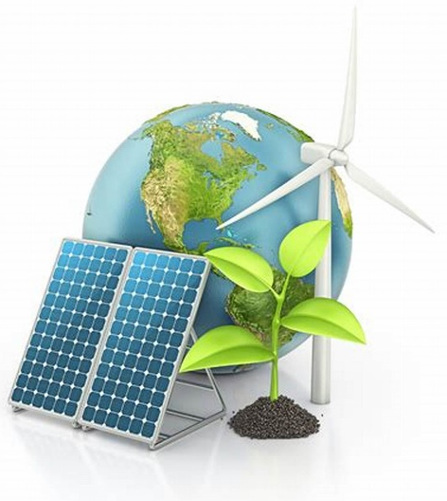
Clean manufacturing approach
The processes and materials used to manufacture, assemble, finish and package products can pollute the air, water and land.
Manufacturers have an environmental responsibility to eliminate pollution and develop a clean manufacturing approach. This could involve:
Use of non-toxic materials
Optimised raw material use
Water reductions, to create less waste water
Air emission reductions
Solid and hazardous waste reductions
Transport and packaging reduction
Energy efficiency, and use of solar, tidal, wind or other renewable energy sources

